Slide 1
‘ ’
horntell
Unpluggd 2014
Notes:
Hey Hiee..
So, here

Slide 2

Trip sponsored by
Notes:
Before we get into the launch, I would like to thank someone, without whom we wouldn’t be standing here today. We didn’t have enough money for this launch trip, but awesome people at RapidMoon (one of our early users) realized the potential of Horntell launching at Unpluggd and sponsored the trip. RapidMoon is the easiest way to build user-interfaces in browser. Very cool product, they have. Definitely, check them out.
Let’s move into the launch then.

Slide 3





story
story
Once Upon A Time…
Notes:
Once upon a time, there were three people (us) working tirelessly on a product called Gaurilla – which claimed to make accounting for startups painless. Last year, we launched and got good feedback and word-of-mouth publicity. Users actually found the product new and awesome. “Shut up and take my money” was the phrase we often heard from our new users. But there was one problem. One little thing.

Slide 4

problem
problem
Y u no has active users!?
2%
active users
Notes:
Just 2% active users.
Instead of having regular sign ups and great feedback like that, there was something broken which put our active rate in the LOL category. We did what most of us sitting over here would have done – running some quick experiments.
We ran a handful of experiments like Drip campaigns (where every user gets a 7-part email course to have better on-boarding experience), transactional emails (which performed quite good actually), and in-app notifications (which worked best).

Slide 5

experiment
experiment
engaging with users manually
mornings
manual in-app notifications
Evenings
manual emails for next steps
Notes:
The experiment went like this.
We decided to engage 10 users manually – which meant, we would track and study their behavior after they signed up. And every morning, based on their behavior, we would send them an in-app notification. Plus on every alternate evening, we sent them an email containing their immediate next steps to help them make more out of the Gaurilla.
Results?

Slide 6

results
results
True story
9/10
subscribed
Notes:
We were able to convert 9 out of 10 users whom we engaged manually. What more is this..
We refined the experiment over a month and automated some parts of it. And voila!
We saw that about 80% of new users explored every feature of the app.
About 76% jump in user activity in the app
53% jump in monthly revenue

Slide 7
horntell
horntell
how we grew
Experiment
Side
Project
Launch
Notes:
What did we do then? We wrapped the whole thing into its separate project and started growing it as a side-project.
We decided to work on it for just once a week as a side-project. And then we started talking to people about it. They went nuts about it. Nuts. Real nuts. You could eat them.
We handed Horntell over to a couple of people and they saw similar growth in numbers. And then we started getting feedback and requirements (air-quotes). We started giving some more time to Horntell and after 6 months, we found ourselves working on Horntell for full time. That’s when we decided to launch it on a bigger scale, which we are doing today.
We want to open up Horntell to a bigger audience now and grow it with full throttle.

Slide 8
how
how
engage users like a boss
Track
Target
Engage
Notes:
About how horntell works.
1. Put a small code in your website, which will render the notification-widget and also start tracking the logged in user.
2. Alternatively, track users and their activity through the API.
Once tracked, you can log into your account to slice and dice the users based on different conditions and engage them in a unique way.
If you want to automate the engagement, set up campaigns and just forget about it. Just focus on watching your numbers grow. These campaigns will be triggered whenever they match some user.
What’s more? Targeting and Triggering happens in real-time. In less than 2 seconds, I mean.

Slide 9
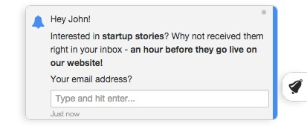
examples
examples
bulk out, Targeted in
everyone who has
commented on a funding story
more than 3 times
Notes:
About how horntell works.
1. Put a small code in your website, which will render the notification-widget and also start tracking the logged in user.
2. Alternatively, track users and their activity through the API.
Once tracked, you can log into your account to slice and dice the users based on different conditions and engage them in a unique way.
If you want to automate the engagement, set up campaigns and just forget about it. Just focus on watching your numbers grow. These campaigns will be triggered whenever they match some user.
What’s more? Targeting and Triggering happens in real-time. In less than 2 seconds, I mean.

Slide 10
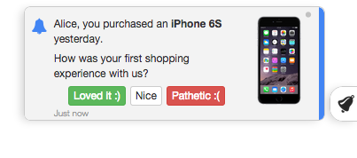
examples
examples
bulk out, Targeted in
whenever someone
buys
for the first time
Notes:
Give more examples verbally.

Slide 11
interactive
interactive
make it easy for them
HTML
be
creative
ASK
interactive
buttons
TALK
interactive
input
Notes:
Give more examples verbally.

Slide 12
api
api
geeky, i know!
<?php
Horntell::notify($user, ‘Johnny has accepted your invitation. We have credited $10 in your account.’);
Notes:
Talk about manual notifications.

Slide 13
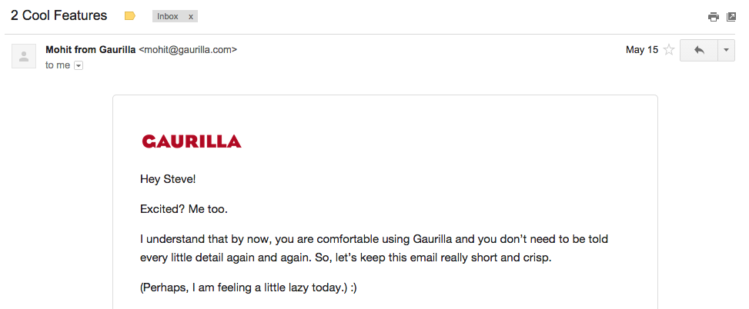
email
email
off-app engagement
Notes:
Talk about emails.

Slide 14

your turn
your turn
it’s your turn now
30% OFF
for UNPLUGGD ATTENDEES
horntell.com/unpluggd
Notes:
Talk about manual notifications.

Slide 15

this can be
YOU

Slide 16
thank you
thank you

